Slide 1
Automated indoor energy control
Submitted To: Submitted By:
Mosharrof Hossain Najim Hossain(10)
Atiqul Islam(26)
Rashed Sami(28)
Assistant Professor
Dhaka International University
Date:23-07-2017

Slide 2
Index
Introduction
Background Study
Tools
Operation
Limitations
Reference

Slide 3

Introduction

Slide 4
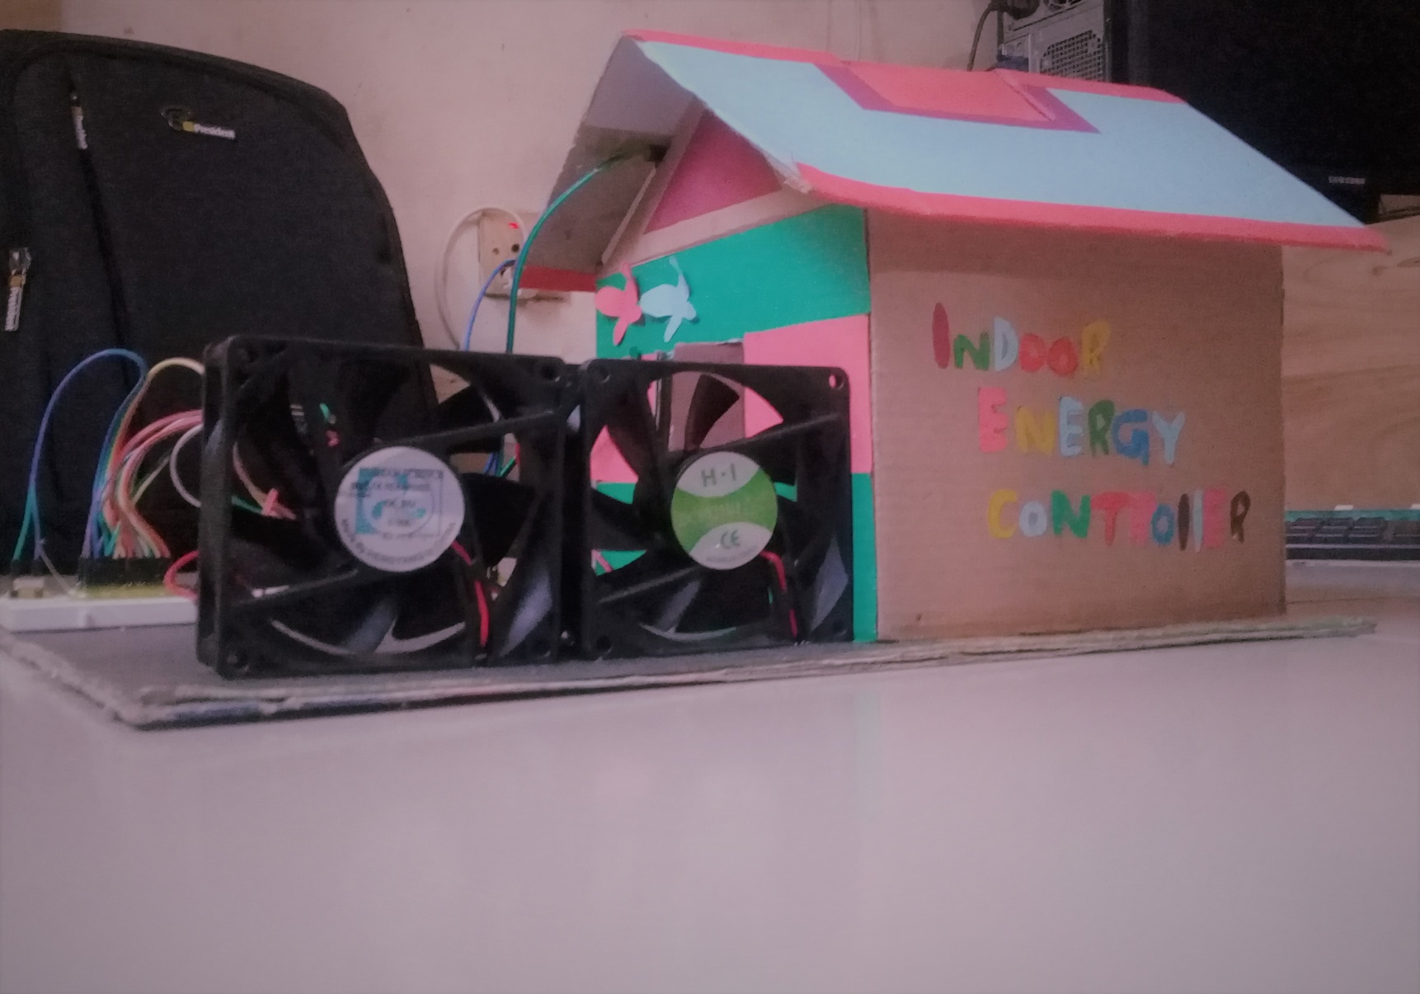

Slide 5
Background study
Present energy scenario of Bangladesh
Products that consumes too much energy
Gather ideas about electronic components
Making relations between these components

Slide 6
Tools
Microcontroller atmega 328
Sensors
16*2 LCD
Arduino IDE
Arduino UNO kit
LED
DC fan
DC 9 volt battery

Slide 7
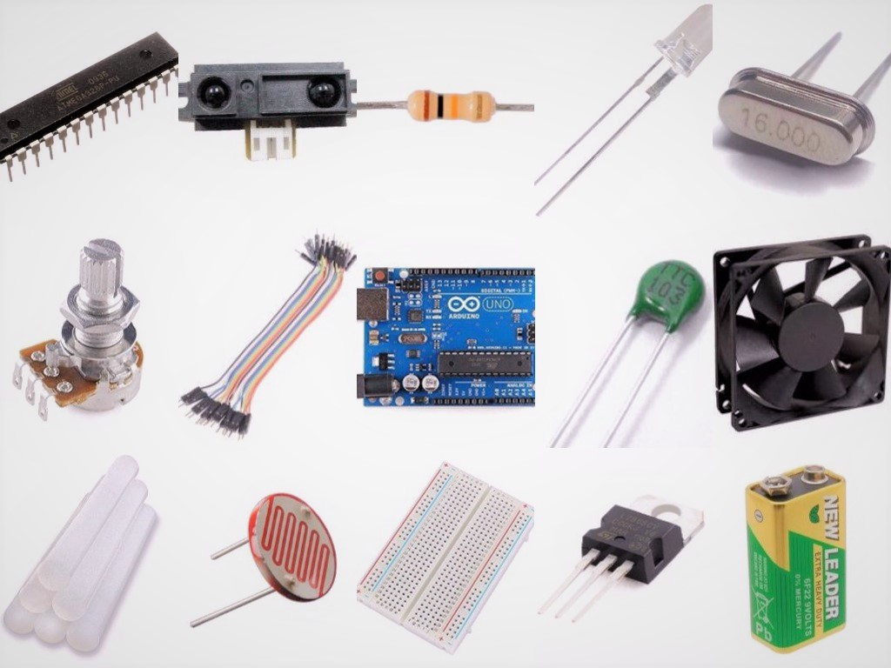
Tools…

Slide 8
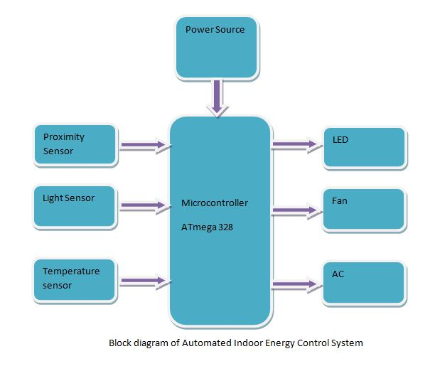
Blockdiagram

Slide 9
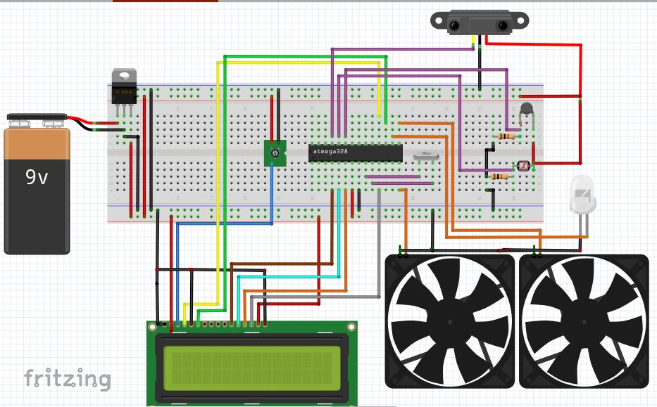
Circuit diagram

Slide 10
Operation
Active Mode
Heavy mode
Medium mode
Low mode
Inactive Mode

Slide 11
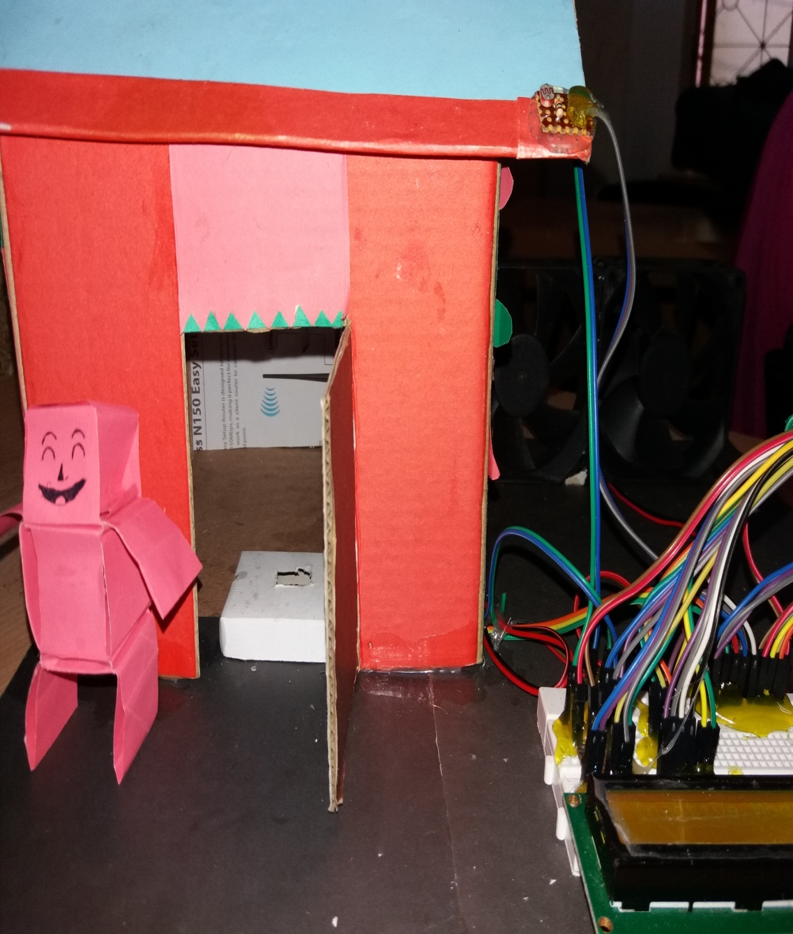
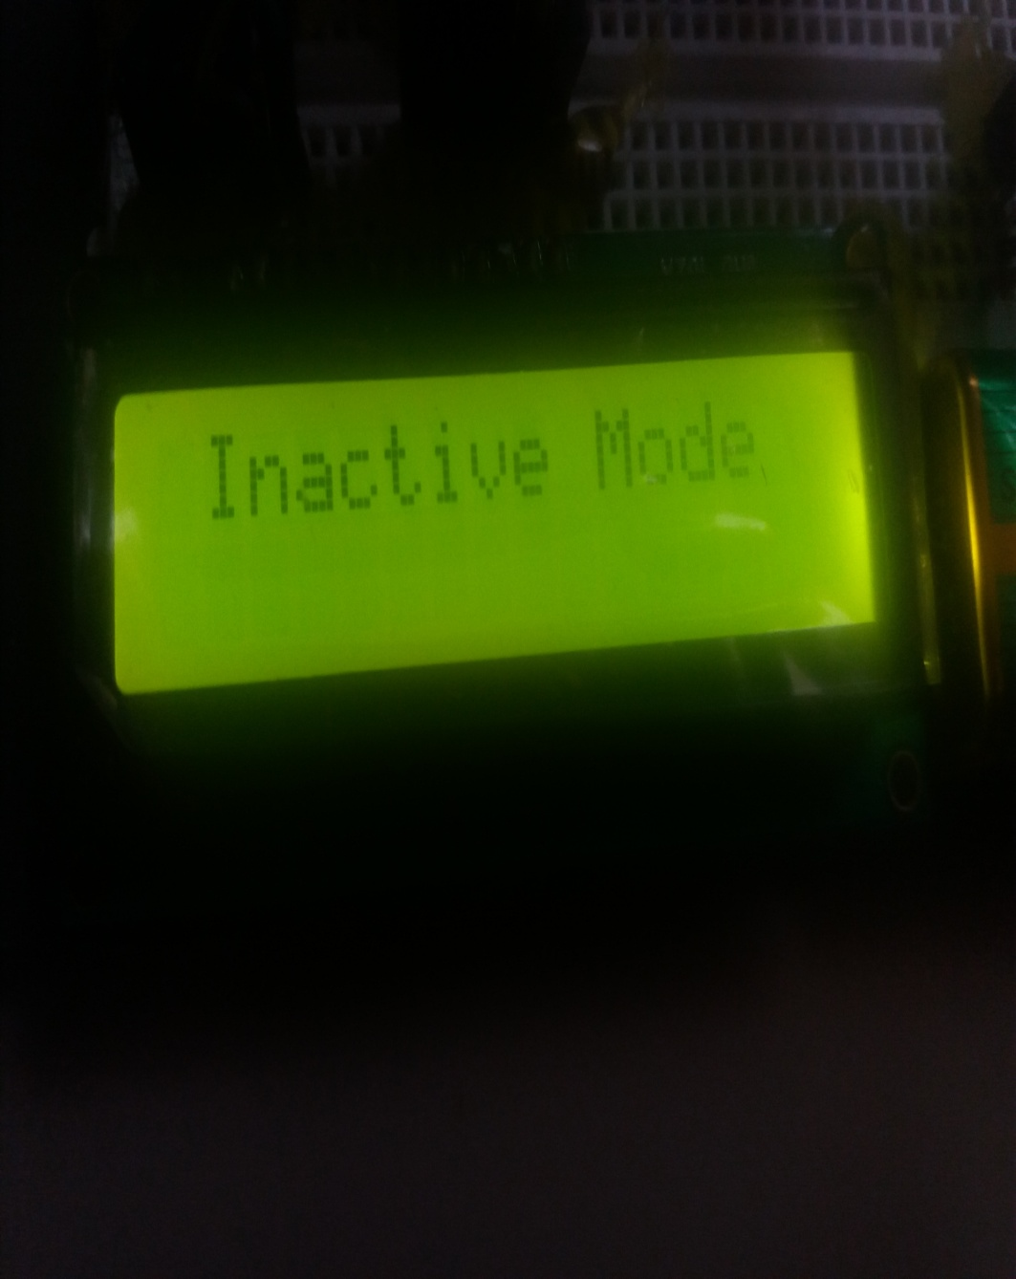
Operation (con…)

Slide 12
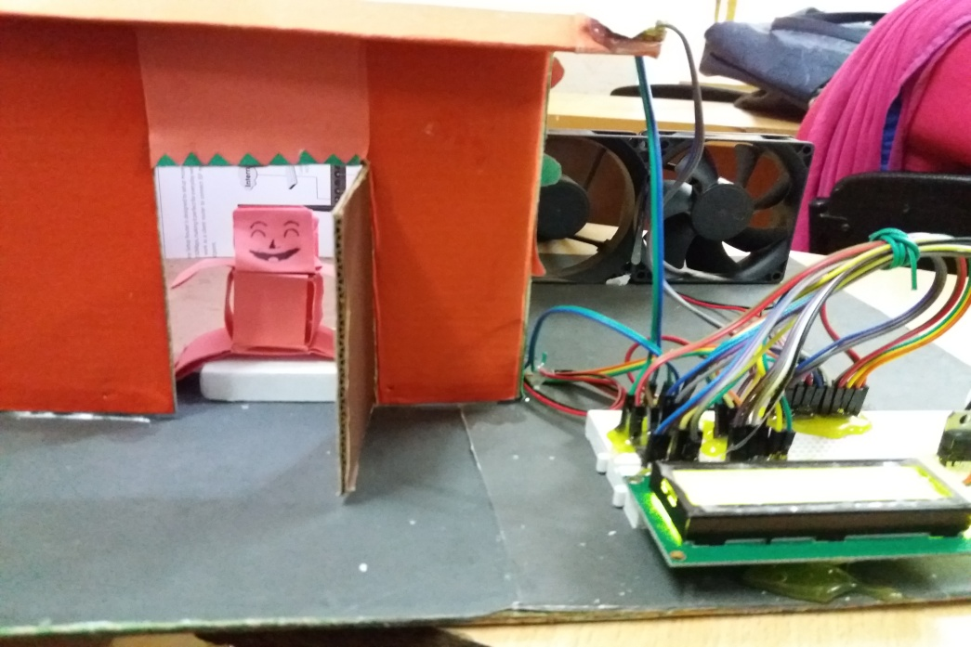
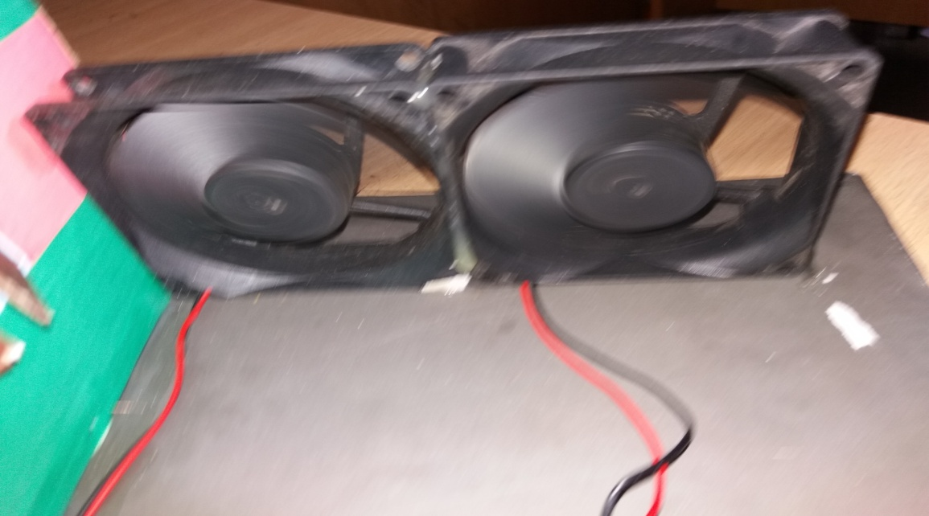
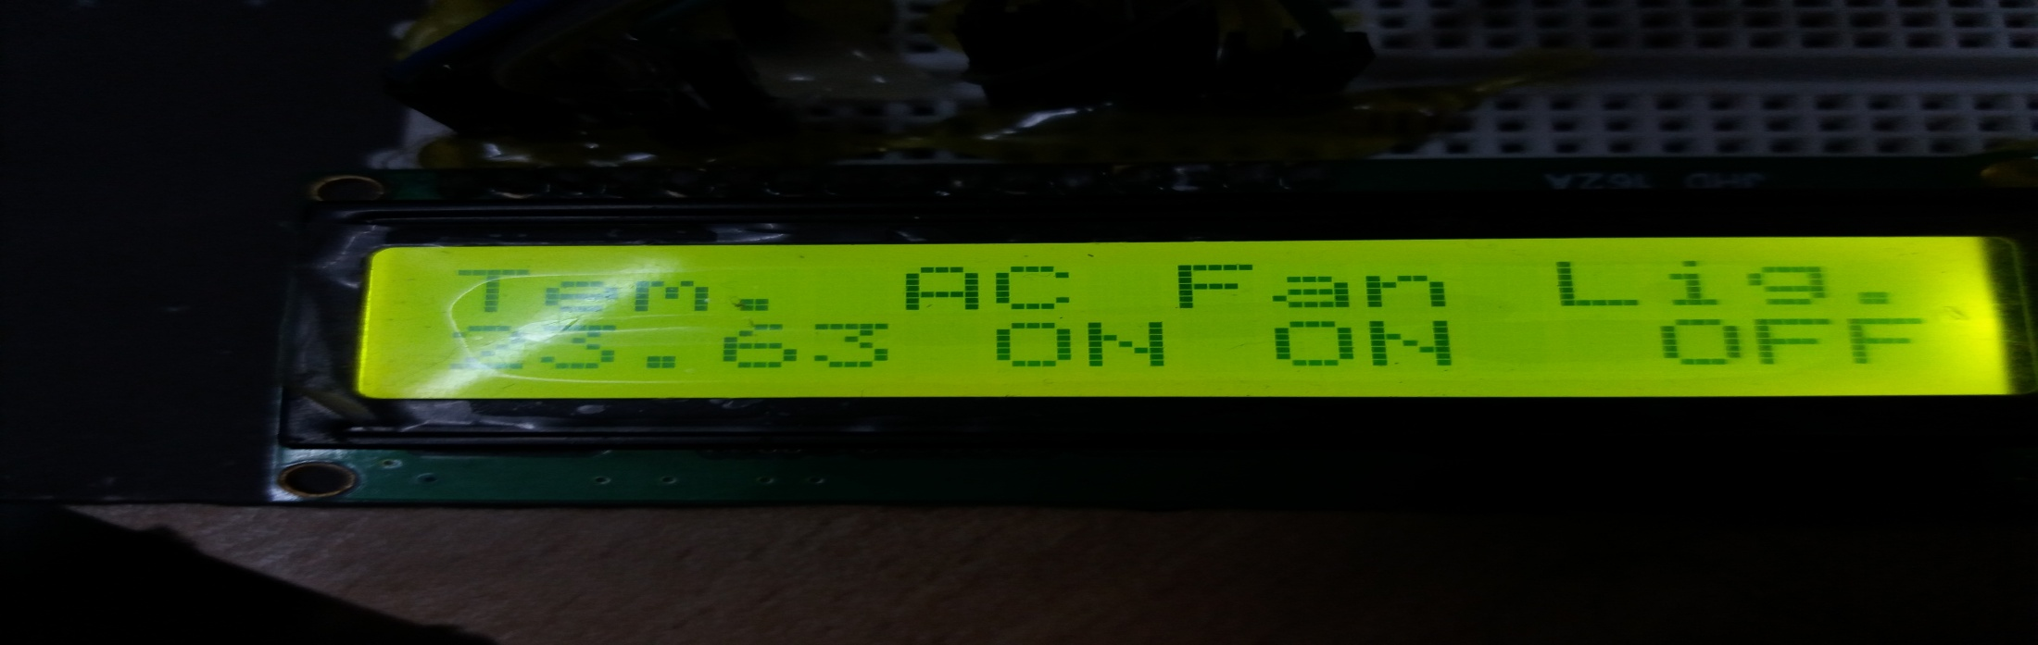
Operation (Con…)

Slide 13
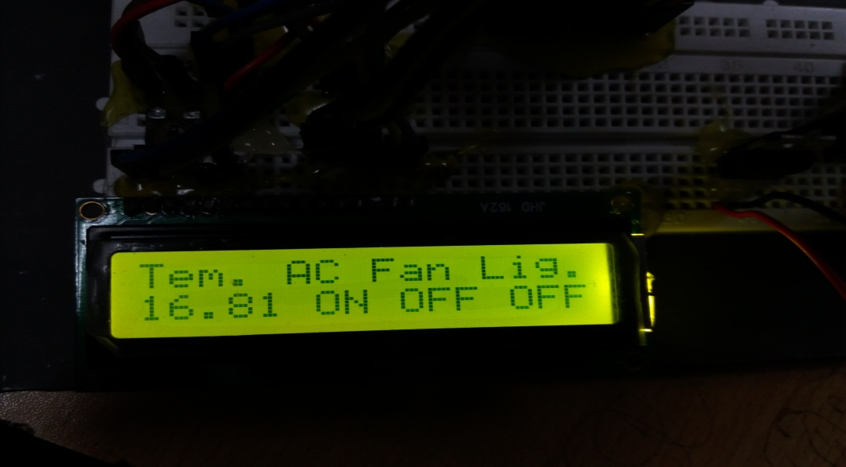
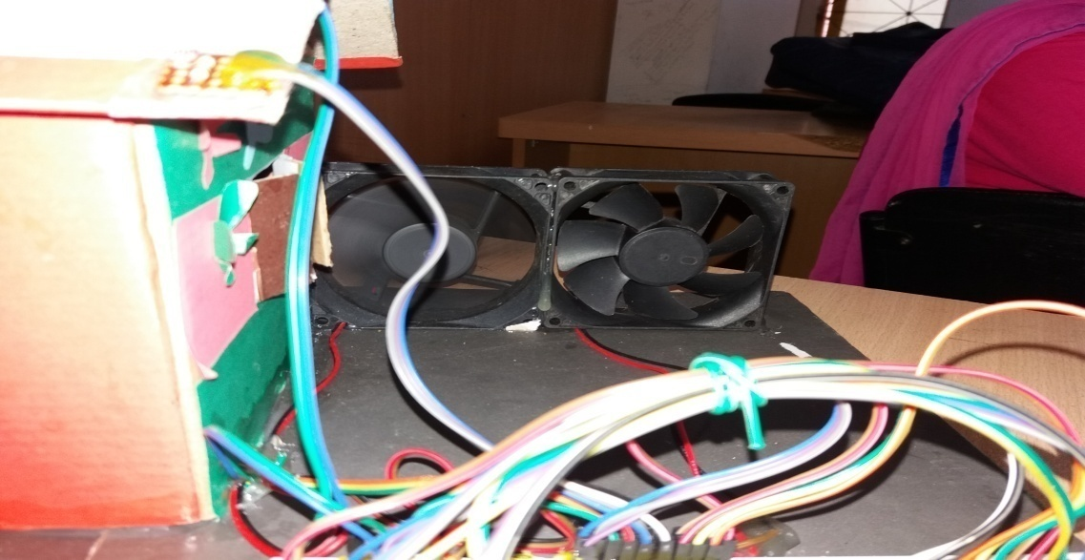
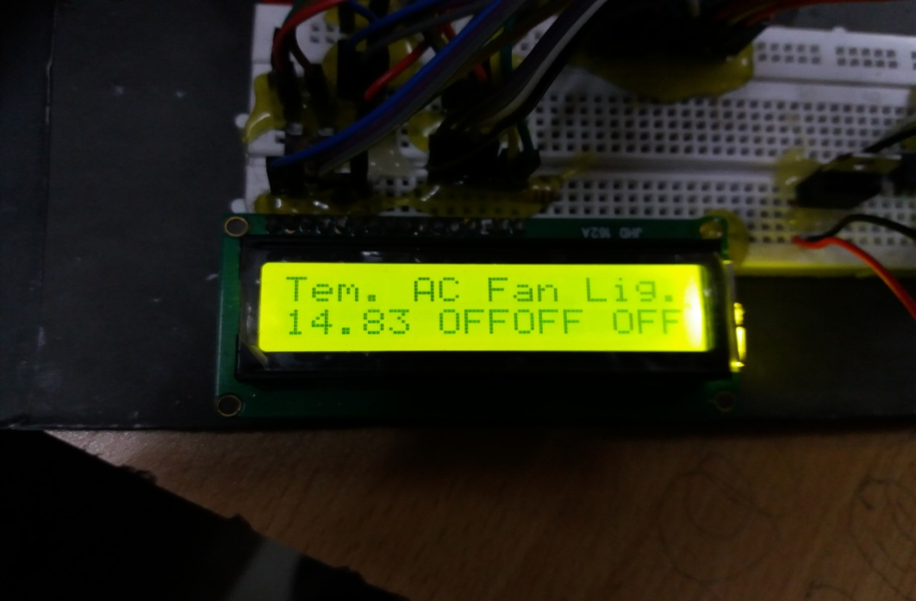
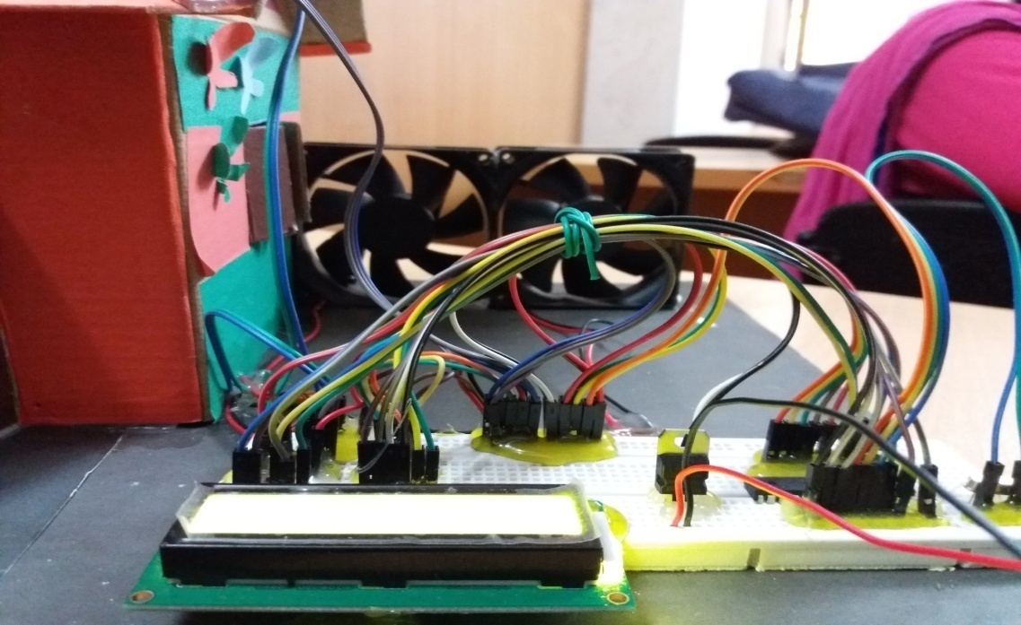
Operation (con…)

Slide 14
Limitaitons
If there is too much people in room then after 15 minutes of changing mode temparature will be increased too much
Microcontroller hangs
Microcontroller shows garbage result.

Slide 15
Reference
https://en.wikipedia.org/wiki/Electricity_sector_in_Bangladesh
http://www.thedailystar.net/op-ed/bangladeshs-energy-options-1362865
https://www.quora.com/How-much-electricity-units-is-used-by-1-5-ton-split-AC
https://www.slideshare.net/amigalib/power-generation-and-demand-in-bangladesh
https://en.wikipedia.org/wiki/Developing_country
https://www.google.com/search?q=bangladesh+population&oq=bangladesh+population+&aqs=chrome..69i57.5046j0j7&sourceid=chrome&ie=UTF-8

Slide 16
??

